Slide 1
SECURE DATA HIDING IN IMAGES USING STEGANOGRAPHY
CAPSTONE PROJECT
Presented By:
Student Name : Ayush Pandey
College Name & Department : Microtek College of Management and Technology, BCA Department

Slide 2
OUTLINE
Problem Statement
Technology used
Wow factor
End users
Result
Conclusion
Git-hub Link
Future scope

Slide 3
Problem Statement
Making the password available during both the encryption and decryption phases was the largest hurdle. I first tried utilizing functions and module imports to connect encryption and decryption. However, problems with variable scope caused this approach to fail. In order to fix this, I created a password.txt file that enables safe password storage and retrieval during decryption.

Slide 4
Technology used
Programming Language: Python
Libraries Used: OpenCV (cv2), os, string
Platform: Windows

Slide 5
Wow factors
Module-Free Approach: No need for complex function calls between encryption and decryption.
Secure Password Handling: Stores passwords separately to avoid errors.
Scalable Design: The project can be extended for advanced encryption techniques.

Slide 6
End users
Security Enthusiasts who want a simple encryption method.
Students & Researchers exploring cryptography concepts.
Developers interested in implementing file-based password management

Slide 7
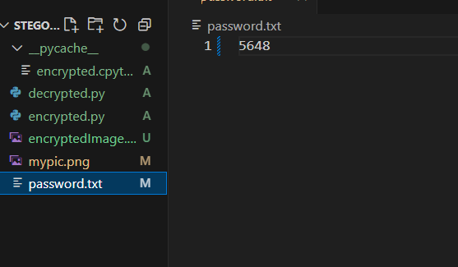
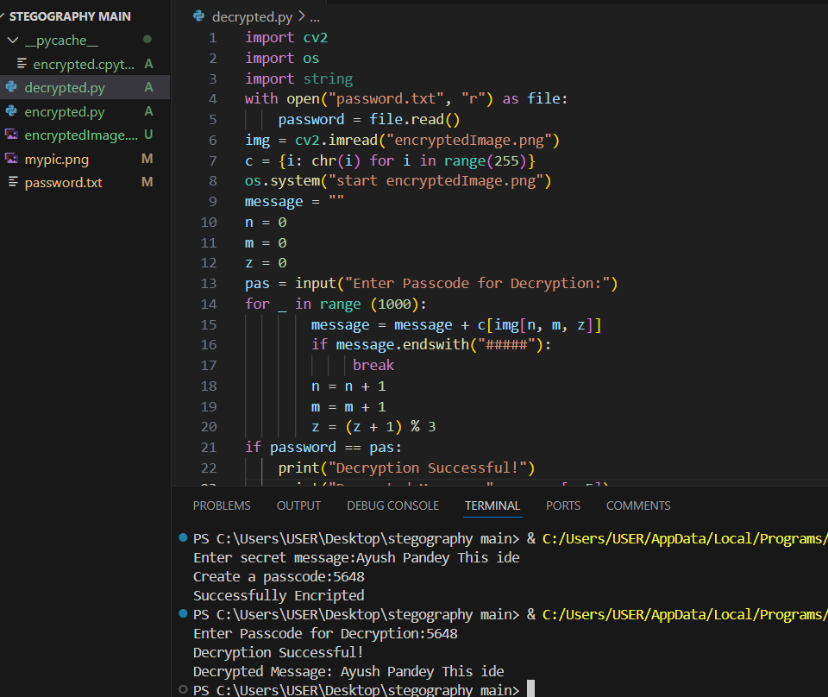
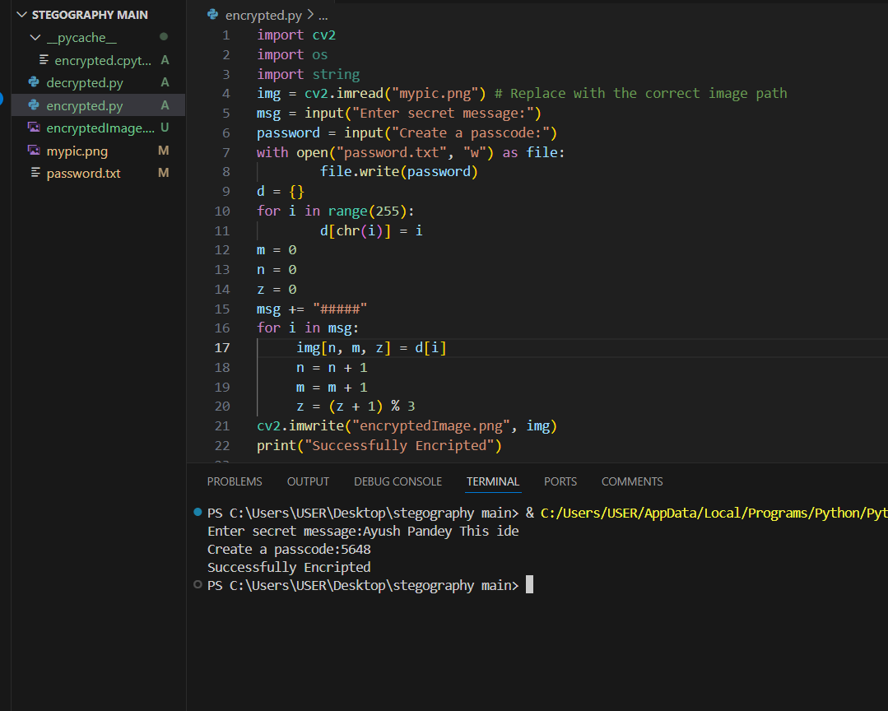
Results
Screenshots of the outcome (min 3)

Slide 8
Conclusion
By removing function-based linking and using a separate password file, the encryption-decryption process is now more efficient and error-free. This project provides a simple yet effective way to securely encode messages within images.

Slide 9
GitHub Link
https://github.com/AyushPandey00/Steganography.git

Slide 10
Future scope(optional)

Slide 11
THANK YOU

